Slide 1
Lending Club Dataset Analysis and Prediction
Yilmaz Mert Akin

Slide 2
Information about Data
Our data has 27 columns and 396030 entries. Each row represents a customer and columns are that customer's features. With this dataset, we would like to predict if it is safe to lend a loan to a customer or not.
The data is taken from Kaggle.
For predictive models I am going to use Deep Learning, Random Forest and XGBoost.

Slide 3
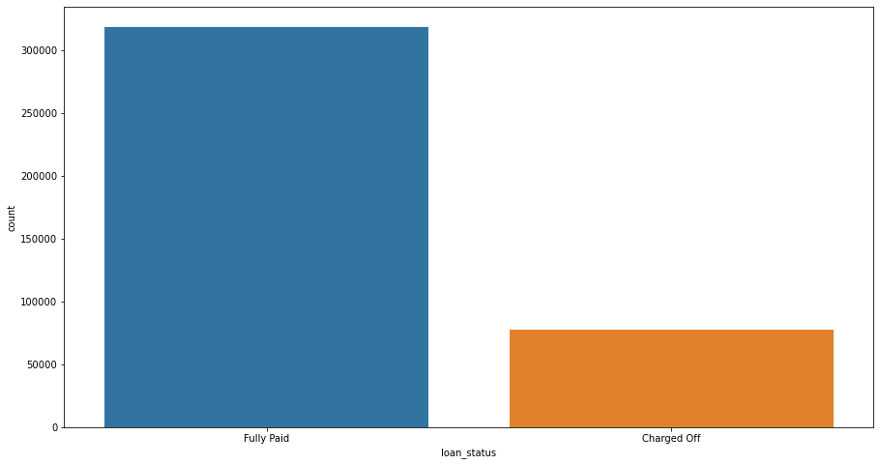
EDA
Approximately 20 percent of the customers are charged off.

Slide 4
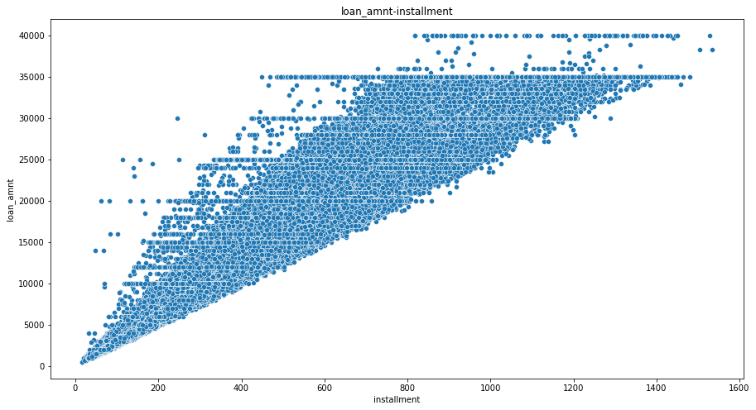
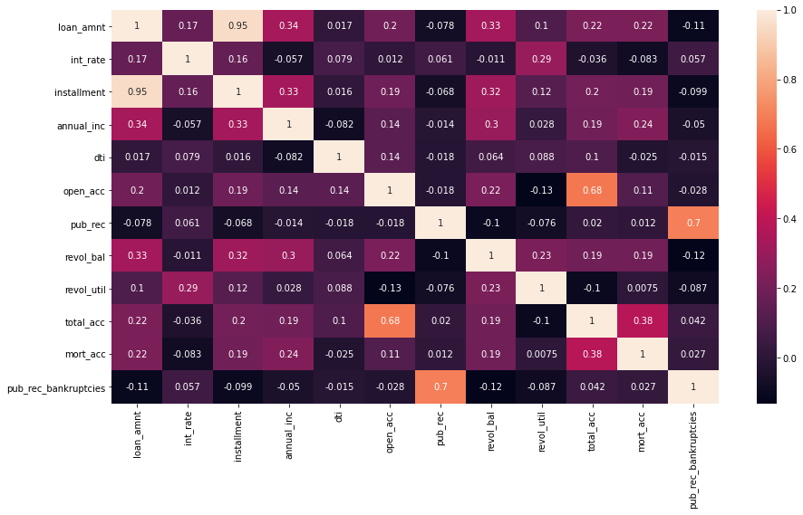
We can see that installment is highly correlated with the loan amount and as installment increases loan
Amount increases as well which is pretty normal.

Slide 5
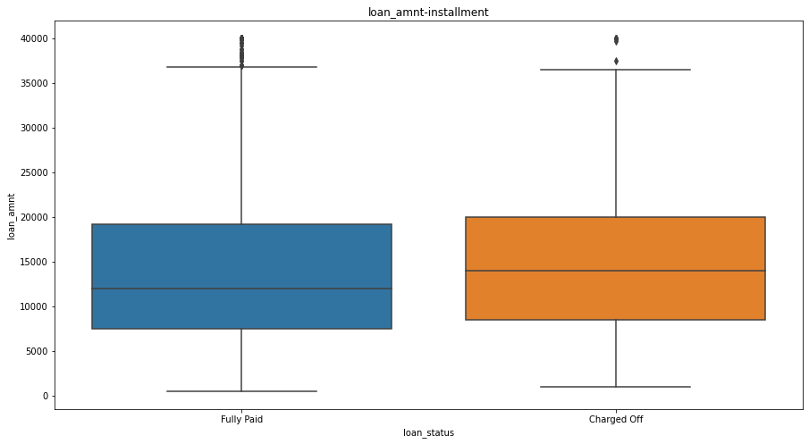
We can see that mean of the charged off is slightly higher than the paid loans.
It is make sense that as the loan amount increases it is likelihood to be charged off.

Slide 6
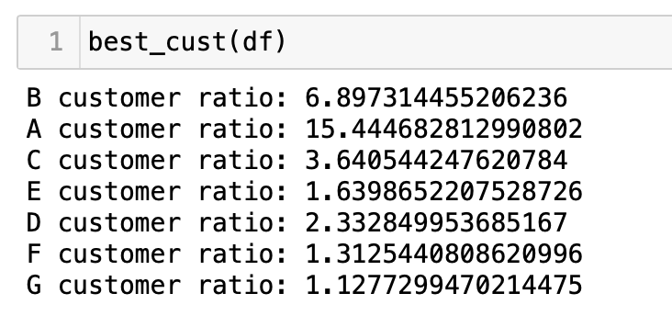
When we look at the grades, we and paid/charged off ratio
We see that A grade loans has the best paid off ratio. Grade F and G loans are most likely to be charged off.
Also B grade loans are the ones that customers apply more than others.

Slide 7
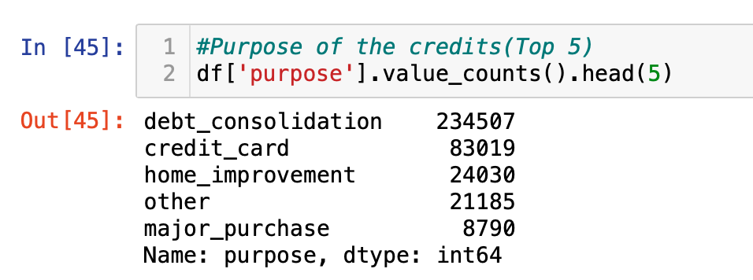
When we look at the graph and purposes, we see that mostly people who lives in a rented house or
Mortgage gets loan and they use it to pay their depts. Home owners mostly get loans to
finance their home renovations

Slide 8
When we look at the loan repaid, we see that interest rate, annual income and number of mortgage accounts
affects loan status more than other features.

Slide 9
Feature Engineering

Slide 10
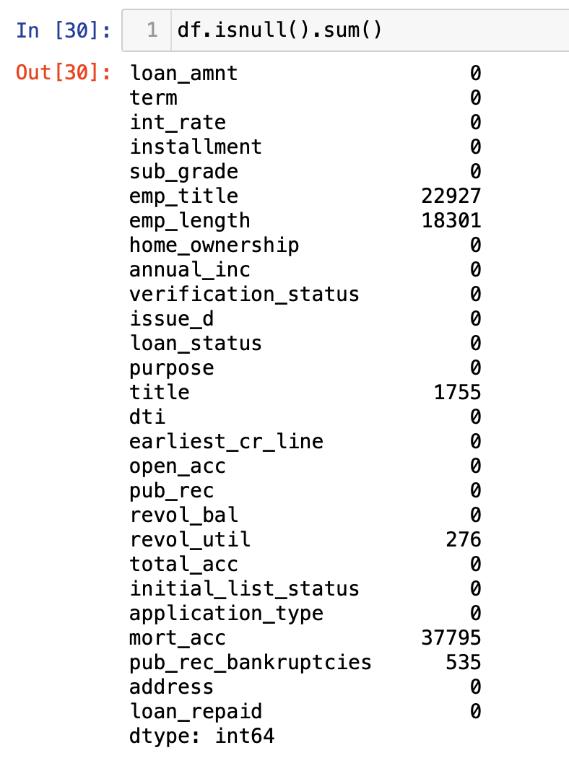
When we look at the missing values employment title, employment length
and number of mortgage accounts features are the ones with most null values.
So we will see if they are useful or unnecessary to be dropped.

Slide 11
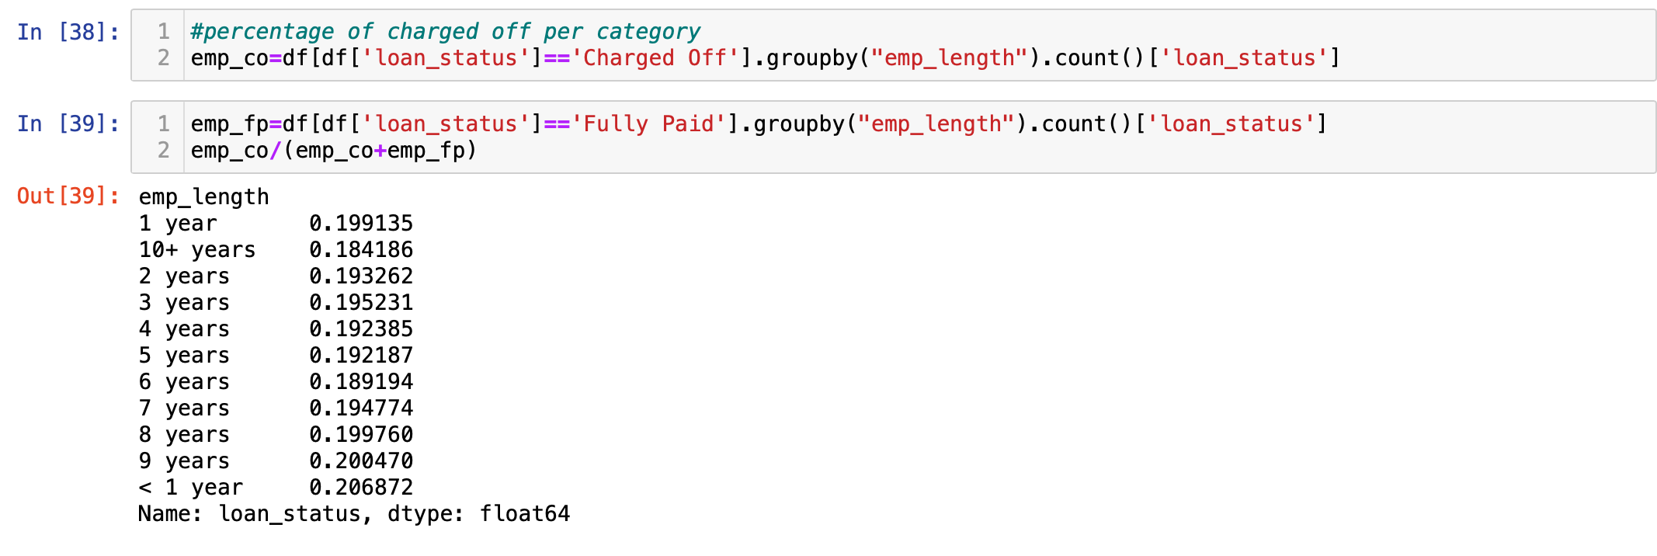
When we look at the employment length we see from less than 1 year to over 10 years.
When we check the correlation to the loan status, we see that there isn’t any significant change,
So there is not need to fill them. So we drop it.

Slide 12
Employment title and title of the loan doesn’t affect the loan status significantly,
so instead of filling them, I dropped it as well.
When it comes to number of mortgage accounts, it shows importance to the correlation, so
I filled null values with mean value of the column.
When it comes to Revolving line utilization rate and Number of public record bankruptcies
features, the number of the null values are so small compared to the whole dataset, so I deleted
those rows since I cannot fill them.
I used encoder on term, homeownership and address columns to turn those string values into
integers to use them in the models that I am going to build.
And before I split data into train and test, I found outliers by using Numeric Outlier method and
removed them.

Slide 13
Model Building
I split data into train(80%) and test (20%) then normalized the data to improves the numerical stability of the model and reduce the training time.

Slide 14
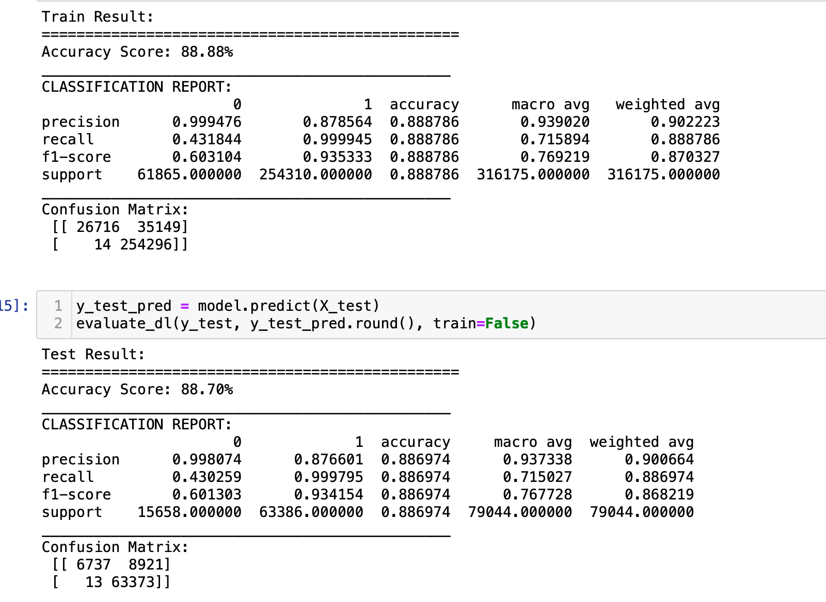
Deep Learning
My Deep Learning model has 78 inputs in the first layer and in the hidden layers I have 39 and 19 dense. For my output layer I used sigmoid function since it is suitable for loan prediction.
Rant: the model accuracy is 88.69% which is fine but not fantastic.
I added extra dense and layers but it didn't make any significant differences.

Slide 15
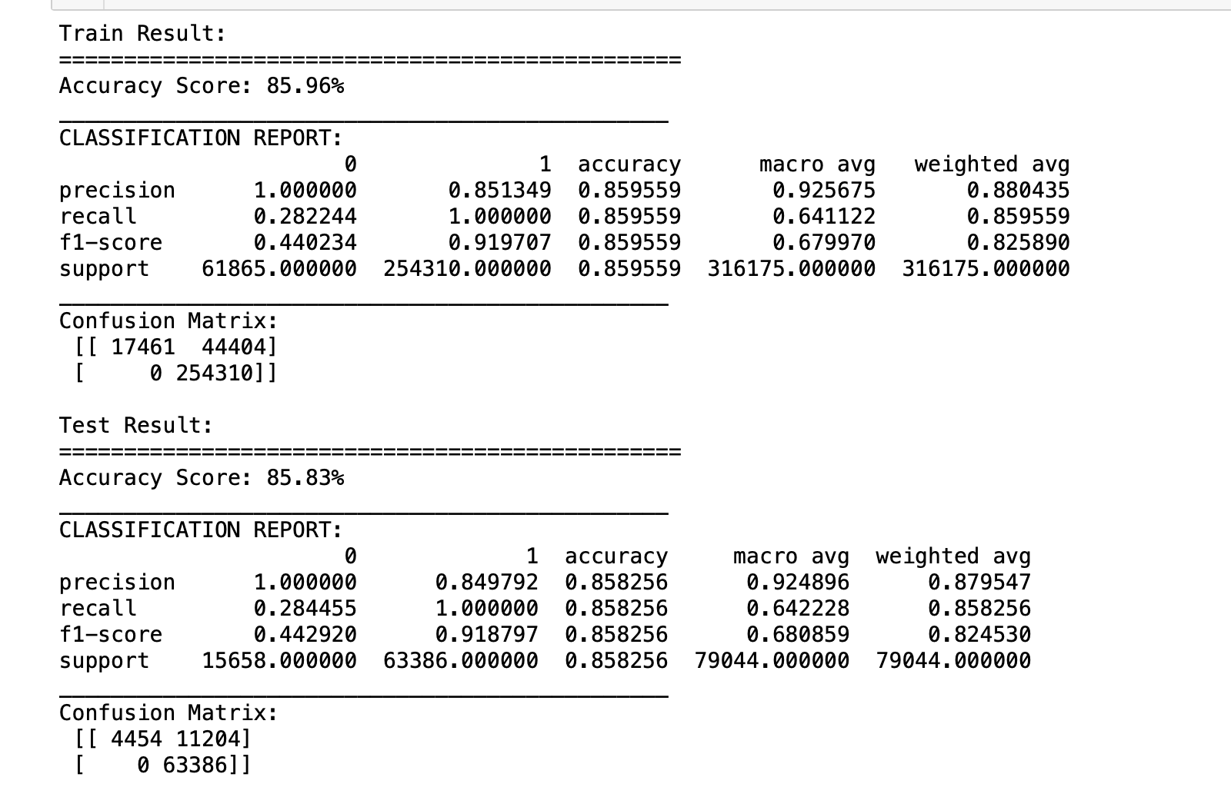
Random Forest
Random Forest was the model that I was expecting to get the best results.
However it wasn’t as good as I expected.
Rant: Model accuracy is 85.83% but when we look at the confusion matrix we see that there are around 14K false predictions which means 14 thousands people who are not eligible for loan but model still tells they are eligible. So it might not be useful by itself.

Slide 16
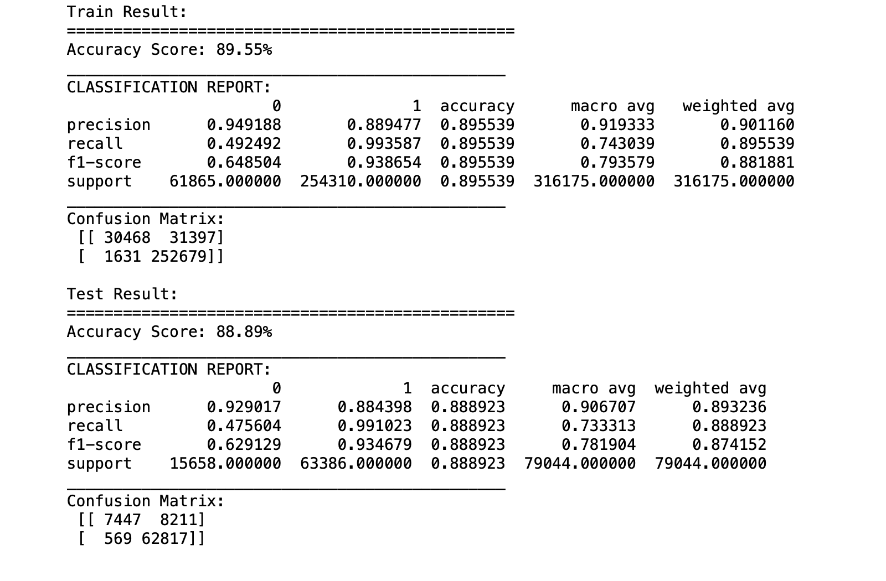
XGBoost
XGBoost is one of the newest algoritms that has a huge potential and
Since it was pretty common for loan prediction problems, I used it for
my project.
Rant: Model accuracy is 88.89% but when we look at the confusion matrix we see that there are around 9K false predictions. 569 people are not eligible for loan but they will get the loan and it is likely going to be charged off.

Slide 17
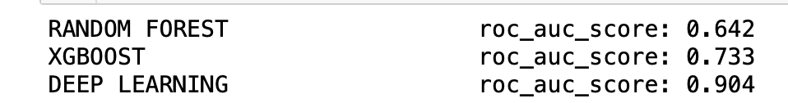
Models Comperation And Rant
When we look at the Roc scores, it is obvious that Deep Learning
gives the best results and I am highly disappointed on random forest algorithm even thought I have used tuning on random forest and xgboost algorithms
In conclusion, deep learning has potential to solve that kind of problems and I believe credit scores for each customers would be a great addition to the dataset.

Slide 18
Thank you

